Slide 1


Design report
高梓源
Notes:
© Copyright PresentationGo.com – The free PowerPoint template library

Slide 2
distinctiveness
Source of ideas
一般的编辑器，共同点：一个文本输入块，一个文件格式
Vscode, Nova, Sublime Text, Xcode
JetBrains, Netbeans, VS, Android Studio
Latex, Word, Markdown
Jupyter NoteBook: 多个文本输入块，多种输入格式
代码：支持多种语言，选择适当内核可运行并输出，主要以python为主
Markdown
Notes:
© Copyright PresentationGo.com – The free PowerPoint template library

Slide 3
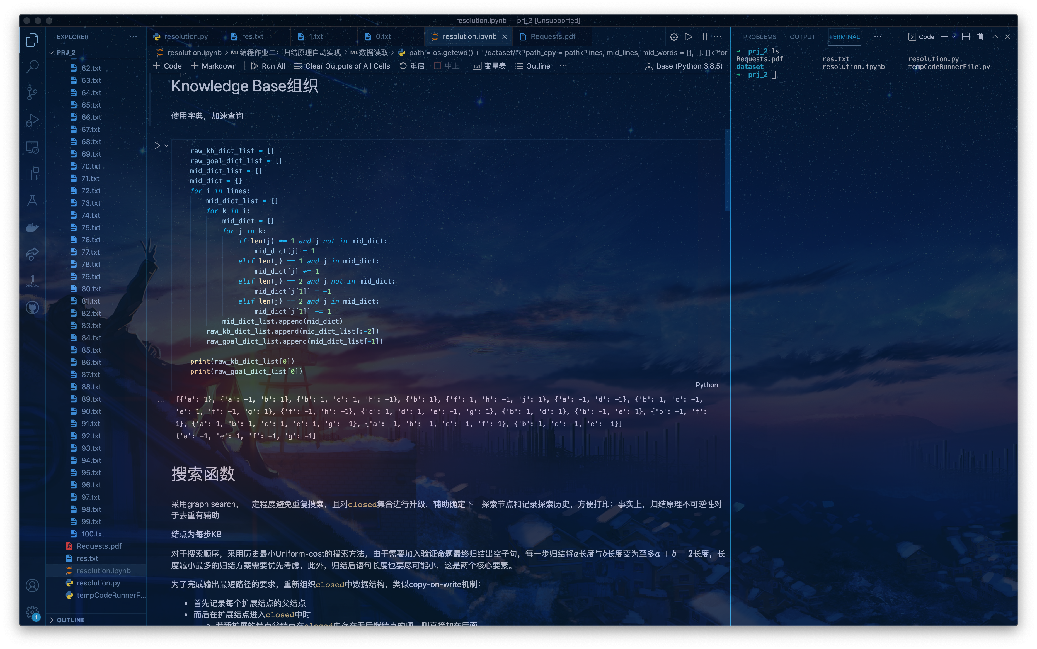
Vscode + Jupyter NoteBook
开发环境颜值天花板

Slide 4
Infinite Notebook
We push it further
吸收：使用块(Block)组织输入输出
我们要为专业人士设计真正通用的编辑器，甚至可以运行代码（外部编译器&运行环境）
可能的输入：
普通文本、富文本、markdown、超文本、无限级标题、专业文本（代码、公式）、表格、多媒体（图片、视频）、分隔符
外观上对标市场：
Menu Bar（工作区、文件、块操作、Git、设置、关于）
Side Bar（文件树、Git信息、大纲信息）
Top Bar（分屏、标签页）
Background

Slide 5
developing environment
Trial and error
Project Manager:
- Maven (switch from Gradle)
IDE:
- Apache netbeans: Coding & Drawing GUI
Light-Weight
Full-Featured: Layout Manager Free-Design
- IntelliJ IDEA: Download External Library with Maven & UML Diagram
GUI Lib:
- Java swing & awt
- (javaFx if only I know earlier)

Slide 6
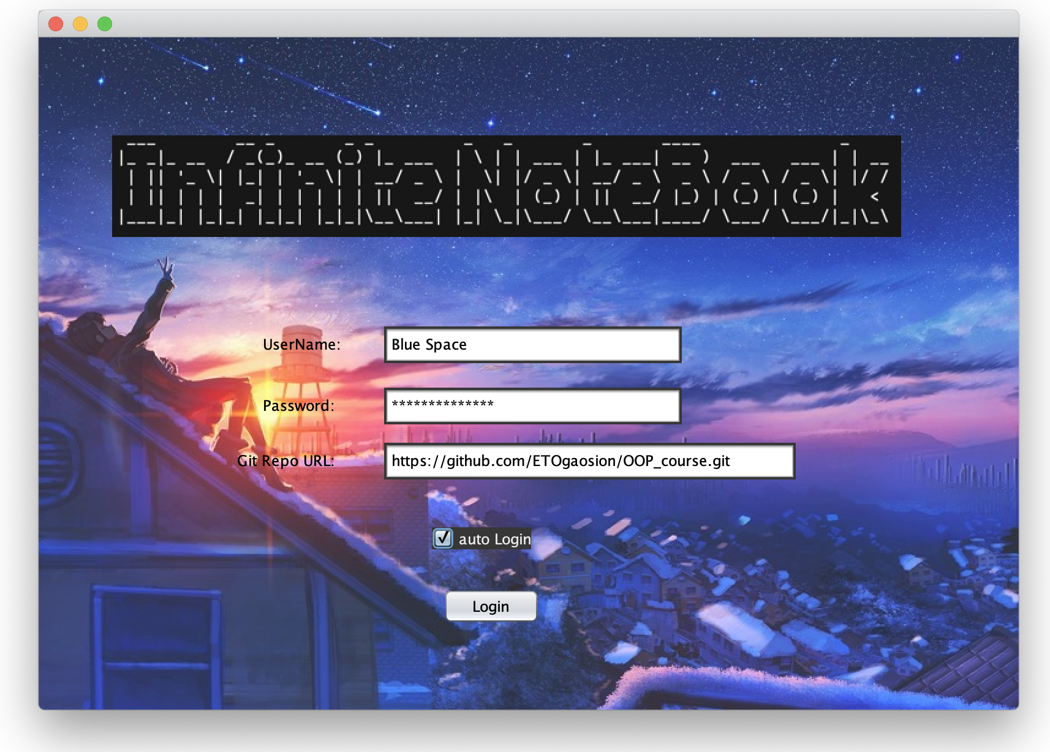
Product overview
V0.0.1 beta
Login view

Slide 7
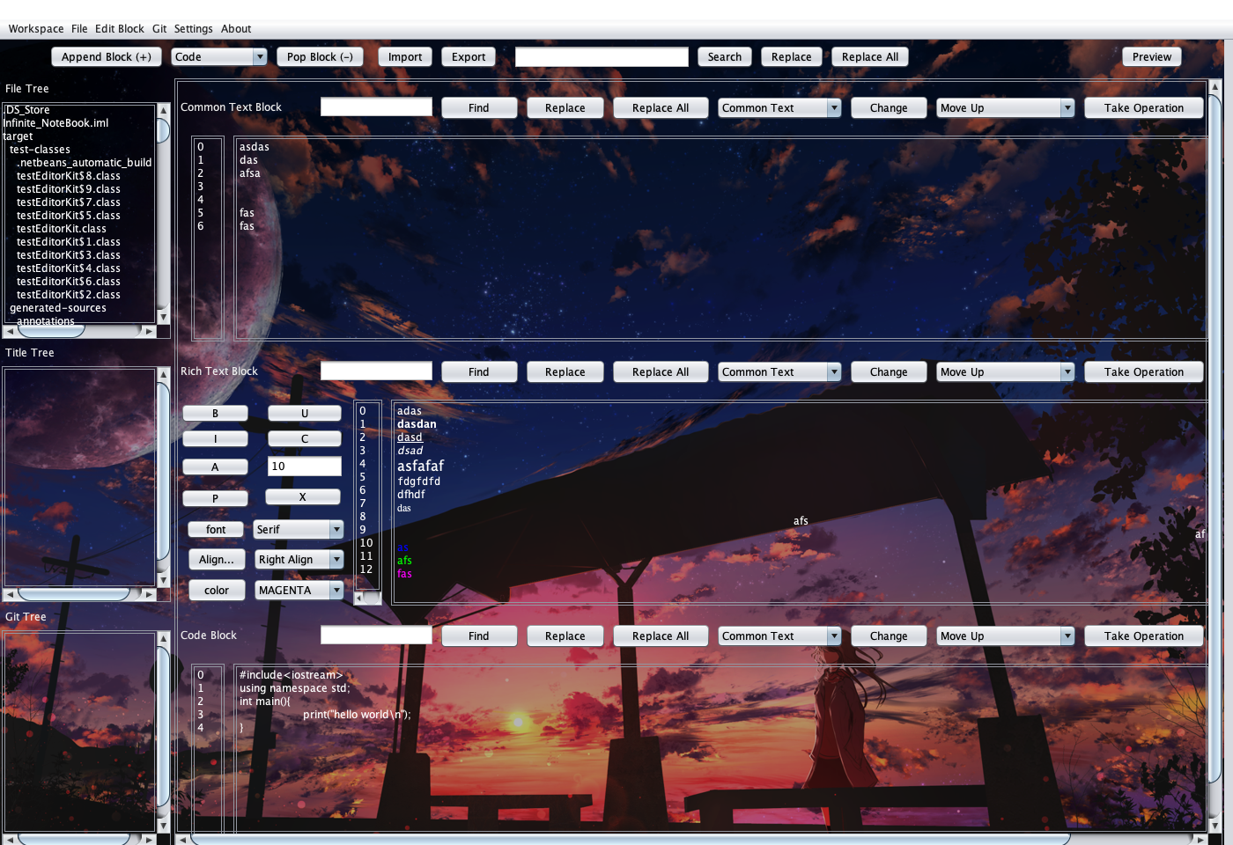
Product overview
V0.0.1 beta: main window

Slide 8
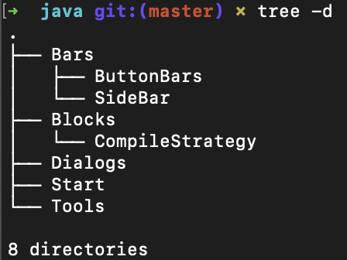
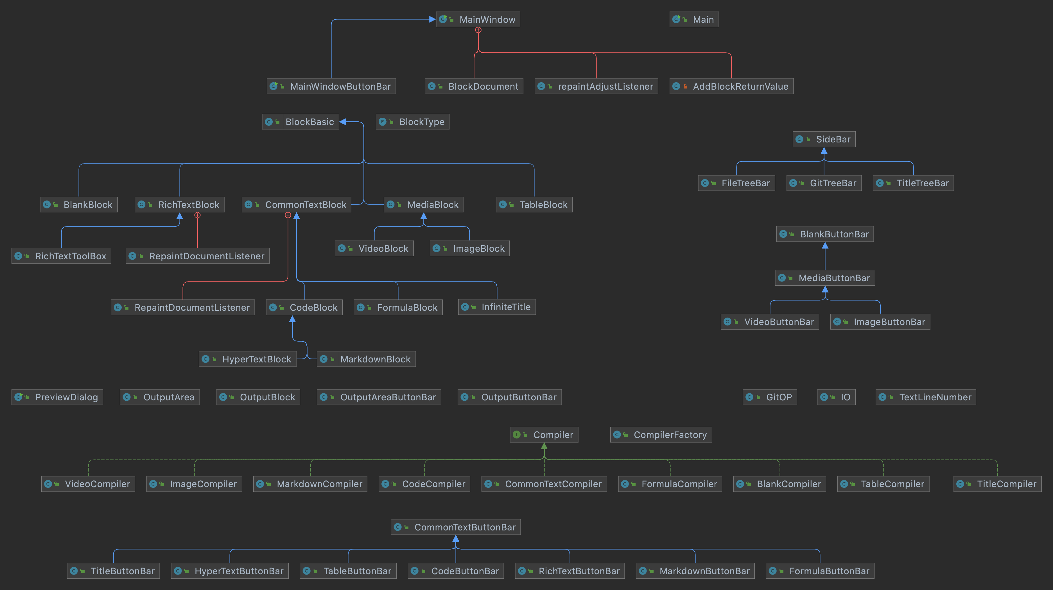
Advanced design pattern
Package management
Class diagram

Slide 9
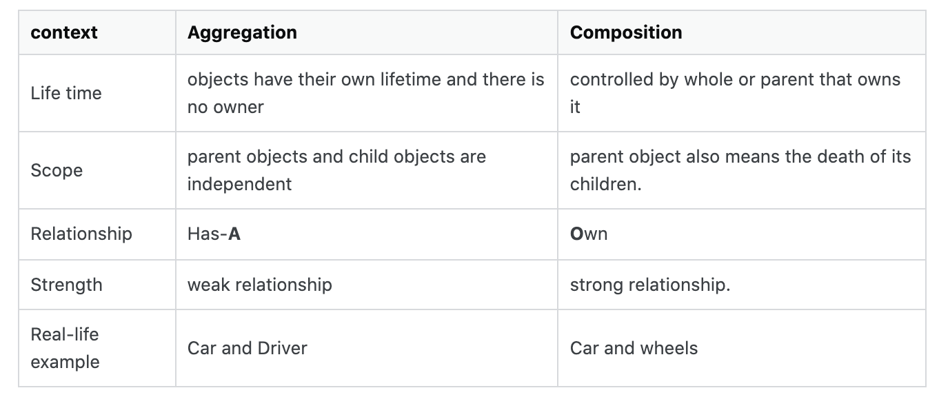
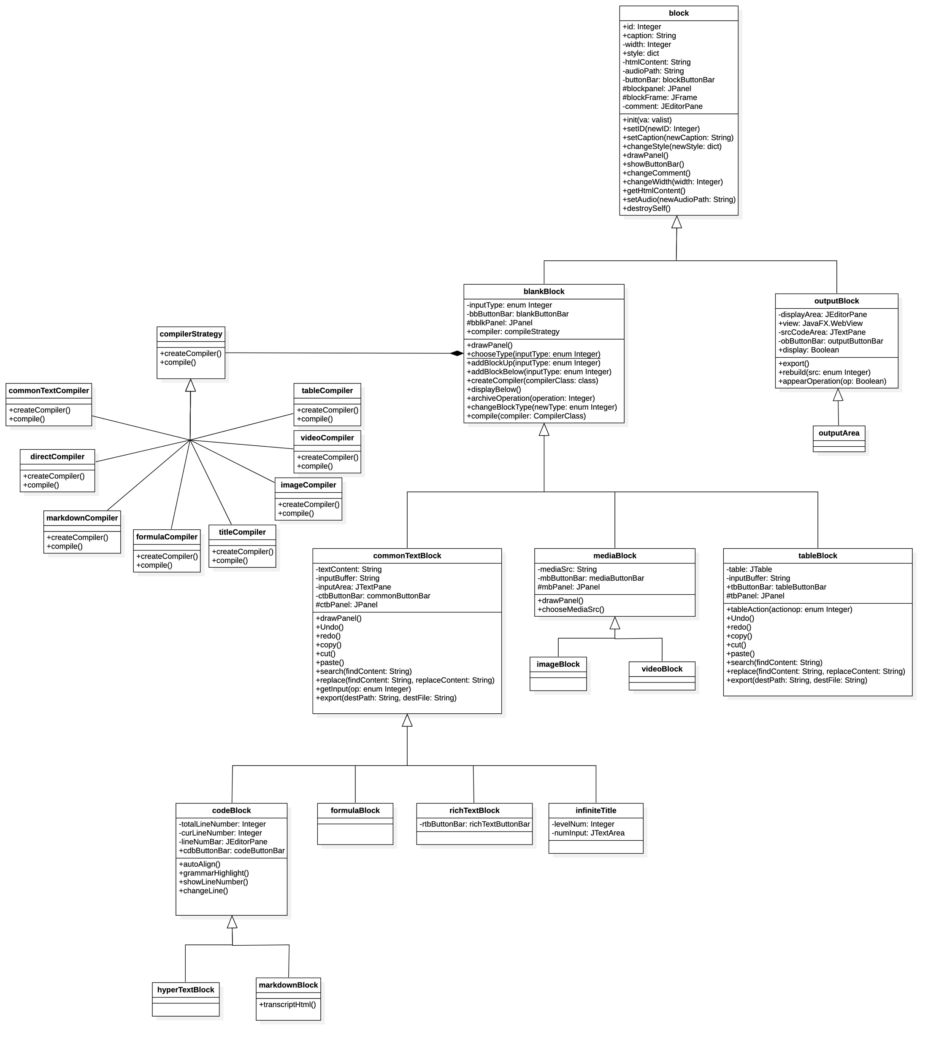
Advanced design pattern
Feature extraction & use of relation
Parent/interface oriented program
What’s in common?
Buttons, Input Areas
Blocks: Input, Media
Avoid repetition
What’s Inheritance?
Whether you want to accept all private fields?
https://en.wikipedia.org/wiki/Composition_over_inheritance
Composition: With partially same features (组合)
Really need inheritance: Parent/interface oriented, Upward Transformation
Advantage: Simplicity (only need to maintain parent)
(like parent prepare all, inheritance like function with args, son choose features)
Aggregation: Has-A (聚合)

Slide 10
Advanced design pattern
(abstract) Factory / iterator / proxy pattern
Compiler, Blocks, Button Bar
Many types, many implementation
POP/IOP, use factory to provide common interface for use
Hide specific implement methods -> user friendly
Many-to-one composition/aggregation:
Blocks in MainWindow, use iterator not index
Input check when compiling/logging in

Slide 11
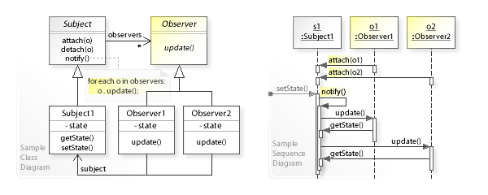
Advanced design pattern
Memento / Observer pattern
Redo/undo manager
GUI core: BUTTONs
Action, Event, Listener
User Action trigger out Events bound with Listener

Slide 12
Why is infinite
Issues: feature requests
This is framework, opensource + plugin mode lead to last-long development
Original Demands & GUI perfection (or switch to JavaFX)
Beautify html output?……
A worry
Under High concurrency environment, trying to access an object from many others (aggregation)
So need locks for every fields of object? Or a lock for an object?

Slide 13

Thanks for listening
Repo: https://github.com/ETOgaosion/OOP_course

